Slide 1
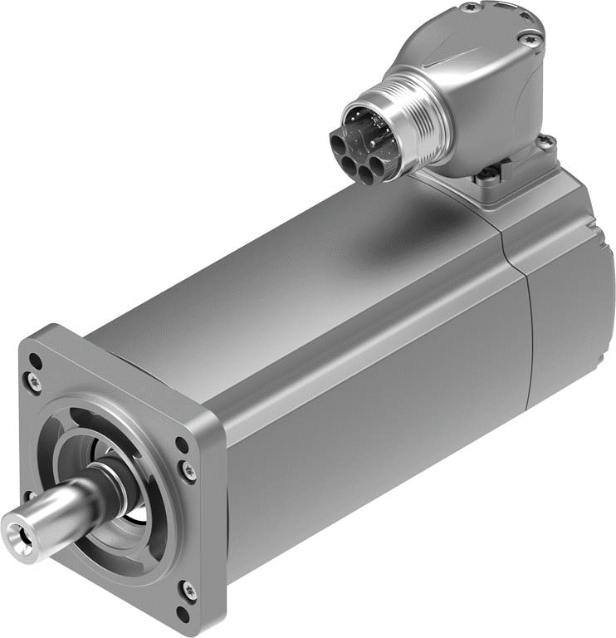
EMMT-AS – Servo Motor – Customer Presentation
Product overview
Product features/Benefit
Arguments & Tools / Support

Slide 2
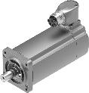
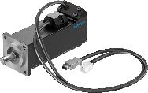
1. Product overview EMMT-AS & EMMB-AS
Festo starts producing its own motors with servo motors series EMMT-AS.
We start with the EMMT-AS series in 3 sizes: (60/80/100 mm flange dimension) in the power range from 190 W … 2,1 kW (M0: 0,6 Nm … 10,8 Nm).
Size 60 is already released, followed with the planned release for
the sizes 80 & 100 by the end of 2019.
Further EMMT-AS sizes and versions will follow up to 12 kW.
We position the EMMT-AS motors as our "Technology Line" for applications and customers with higher requirements and demands.
By this we mean:
Environmental conditions, connection technology (OCP - One Cable Plug), performance, overload capacity and variance in the versions.
In the demarcation / differentiation to this, we also have the servomotors of the EMMB-AS series, which we position as the "Basic Line".

Slide 3
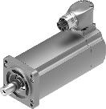
1. Product overview EMMT-AS & EMMB-AS
EMMT-AS Synchrony Servo Motor:
6 flange sizes - within 50W … 12kW
EMMT-AS (-40)* / -60 / -80 / -100 / (-140 / -190)*
Asian motor flange and shaft sizes
Each size in up to 4 length
Different winding characteristics
OCP – Cables (One Cable Plug)
Encoder - single and multi turn absolute – battery less
With or w/o holding brake
Higher temperature range / less derating
Supports max. cable length up to 100m
List prize index: 100%
)* in planning, no schedule yet
EMMB-AS Synchrony Servo Motor:
3 flange sizes - within 100W … 750W
EMMB-AS-40 / -60 / -80
Aligned to Asian motor flange and shaft sizes
Up to 2 length
Standard winding
Cable tail with plug
Encoder - single and multi turn absolute – battery
With and w/o holding brake
Lower temperature range / more derating
Supports max. cable length up to 25m
List prize index: 70%

Slide 4
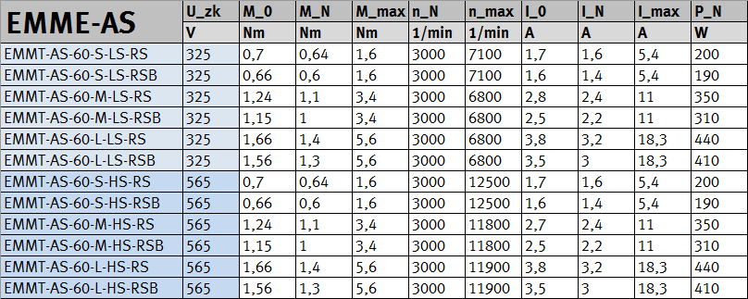
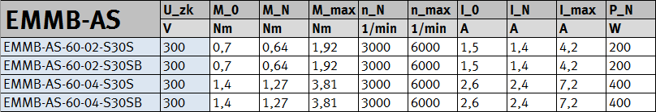
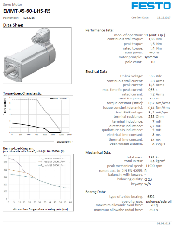
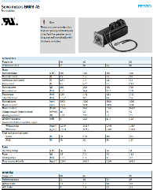

1. Product overview EMMT-AS & EMMB-AS
Technical Data (basic):
Technical Data (basic):

Slide 5
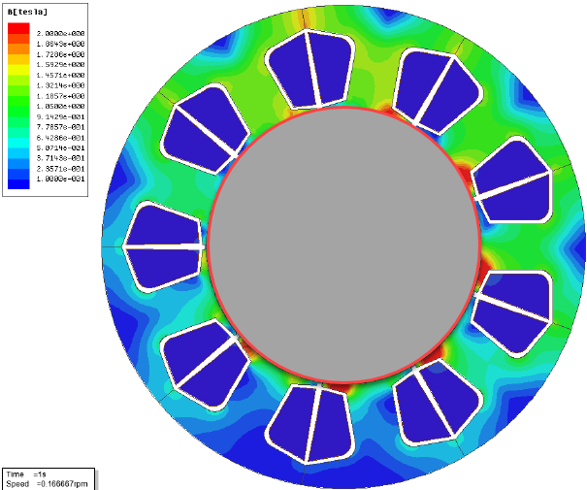
1. Product overview EMMT-AS
EMMT-AS Synchronous Servo Motor:
The electromagnetic motor design is optimized for use with Festo automation components and is characterized, for example, by an extremely low cogging torque, which allows good controllability and good tracking accuracy in positioning tasks.
The entire motor series uses high-energy, corrosion-resistant and high-temperature NdFeB magnets, which ensure high torques and efficiencies. Servo applications increasingly require good tracking accuracy during the movement. At the same time, a good linearity between current and torque should prevail for good controllability even in the small signal range.
The EMMT series motors have been specially de-signed to do so by choosing a magnetic circuit de-sign that has a semi-closed stator and rotor groove design with embedded magnets in the rotor iron.
As a result, the Festo motor of the EMMT series has an extremely low cogging torque.

Slide 6

1. Product overview EMMT-AS
EMMT-AS Synchronous Servo Motor:
Technical key data EMMT-AS:
Smooth, 2-layer painted surface in Festo silver
Degree of protection IP 67: entire housing with connection technology (connected state)
Degree of protection IP 40: on the shaft, optionally with PTFE sealing ring IP 67 (also suitable for dry running)
Motor integrated temperature measurement, which is transmitted via the encoder protocol, interference-proof, digital.
Digital type plate, all important motor data are stored in the motor and can be read out by the servo drive during commissioning.
Digital single turn absolute Encoder EnDat 2.2® with digital type plate; Better control characteristics, better synchronization (especially at low speeds - constant speed), via the digital type plate the servo-drive recognizes the motor - faster, easier and safe commissioning.
Optional digital multi turn absolute encoder EnDat 2.2 ®, absolute within 4096 motor revolutions (even when powered off). If motor rotations are detected and resolved, no reference travel is required after "Power On".
Approvals:
CE mark according to EU Low Voltage Directive, EU EMC Directive, EU-RoHS-RL
c UL us - Recognized (OL), File-Nr: E342973; RCM (Regulatory Compliance Mark)

Slide 7

2. Product features/Benefit EMMT-AS
Coordinated motor program for our mechanical drive components.
--> Safety and convenience: The customer gets the power he needs, easy to build in/on, fit, easy to put into operation and everything from a single source.
Smooth, 2-layer painted surface in protection class IP 67, shaft optional up to IP 67 (dry running suitable – short time)
--> Safety: easy to clean and safe to use
Award-winning design: iF Design Award 2018
--> Image: good looks and feel
Very low cogging torque / cogging
--> Performance and reliability: good controllability and true tracking in positioning tasks
High power density
--> Performance and efficiency: more power from smaller space -
less space required, better for cultivation and mechanical integration, thereby z. B. possible in-crease of the payload within a portal system.
Motor integrated temperature measurement
--> Safety and reliability: digitally transmitted and interference-proof, additional monitoring of the motor temperature to I²t monitoring in the motor controller

Slide 8


2. Product features/Benefit EMMT-AS
Digital type plate
--> Convenience: all important motor data are stored in the motor and can be read out by the servo drive controller during commissioning. Thereby simple and fast commissioning.
Optimized connection technology OCP (One Cable Plug)
--> Convenience and cost-effectiveness: only one motor cable for power, signal and holding brake (optional) - less space required, only one cable for easier and better routing, cost reduction.
Maintenance-free operation - bearings with life-time lubrication (~> 20,000 h); This applies to the engine as well as the optionally available gear boxes.
--> Convenience and economy: no maintenance required, long life
Dimensioning and selection of the suitable motor for the application with the axis by using PositioningDrive.
--> Convenience and economy: Safe and fast drive design.
Available
Available
CMMT & Motors - integration in PositioningDrives
CMMT & Motors - integration in Automation Suite

Slide 9

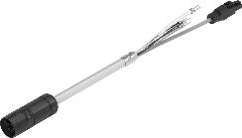
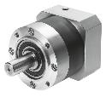
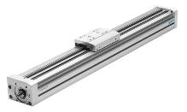
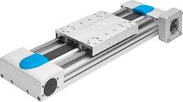
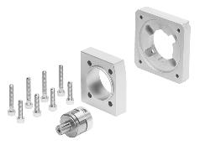
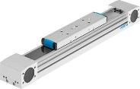
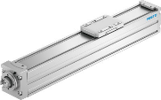
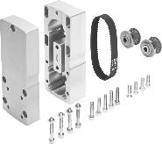

2. Product features/Benefit EMMT-AS
Stocked accessory program with:
--> Convenience and service:
  NEBM, Cost-optimized OCP (One Cable Plug) motor cable program, suitable for drag chains
  EMGA, Standard Eco gearbox in i = 3 & 5 - Other gear types, versions and gear ratios on request.
  EAMM-A, Axial kits for extended combination options for mounting Mechanics to motor, also in IP65 (-S1 version) - depending on the mechanics
  EAMM-U, new parallel kits for extended com-bination options for mounting mechanics to motor, now also in IP65 (-S1 version) - depending on the mechanics
EAMM-A
Festo Actuators
EAMM-U

Slide 10
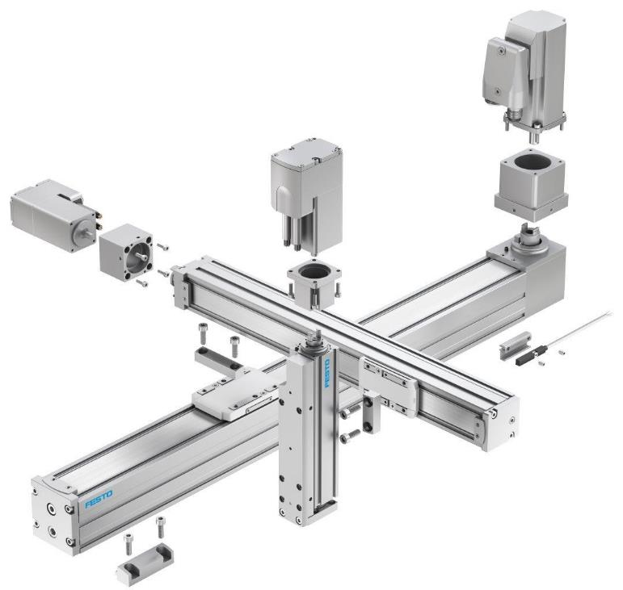
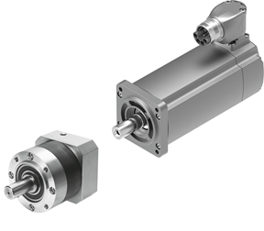
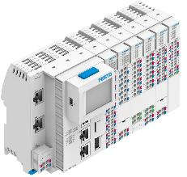
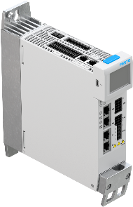


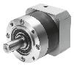
2. Product features/Benefit EMMT-AS
One stop shopping - Cross selling potential
Cross selling
Today: Axes
Today: Axes→ motor
Today: Axes→ motor→ drive→ PLC
Today: Axes → motor→ drive→ PLC
Tomorrow: PLC→ drive→ motor → axes→ sensors
Tomorrow: Drive→ motor → axes
Tomorrow: PLC← drive→ motor→ axes

Slide 11






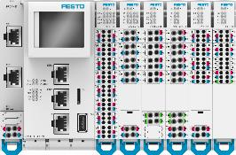
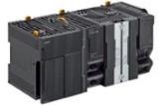
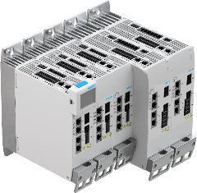








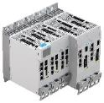


2. Customers need for ...
Festo Automation Suite
Host- PLC
Ethernet
Ready for Industry 4.0
Festo Automation Suite:
Functionality of FCT, FFT, FMT & CODESYS now combined in one software
Intuitive, consistent user interface design
Considerable reduction of time and efforts for commissioning of Festo components
CPX-E Automation system:
Compact control and Remote IO-System
PLC/ Motion functionality Integrated host communication (PROFINET, EtherNet/IP)
Fast EtherCAT master interface
CMMT-AS:
Price and size optimized Servo drive
Same drive for all major PLCs and fieldbuses
Easy and fast wiring of multiple drives
CPX-E-CEC
Motion Control System
Encoder
IO-Link
Valveterminal
HMI
Ethernet
CPX-E Remote I/O
Vision
CPX Terminal
CMMT-ST
CMMT-AS
Safety-PLC
Third party products

Slide 12

Festo AG & Co. KG
Thank you for your attention

