Slide 1
Slim and self-adjusting
Round cylinders DSNU, ESNU and DSNU-S

Slide 2
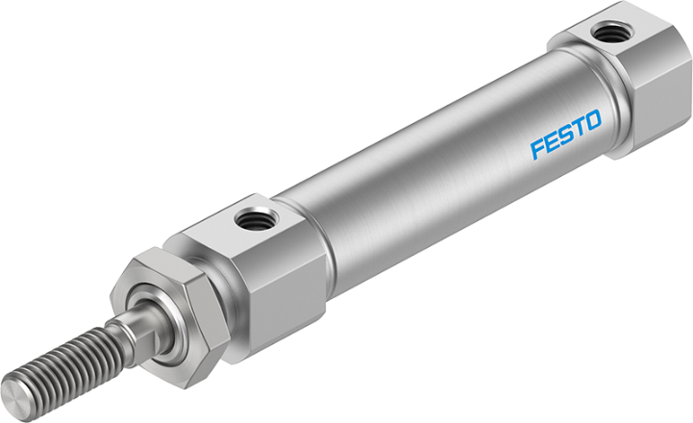
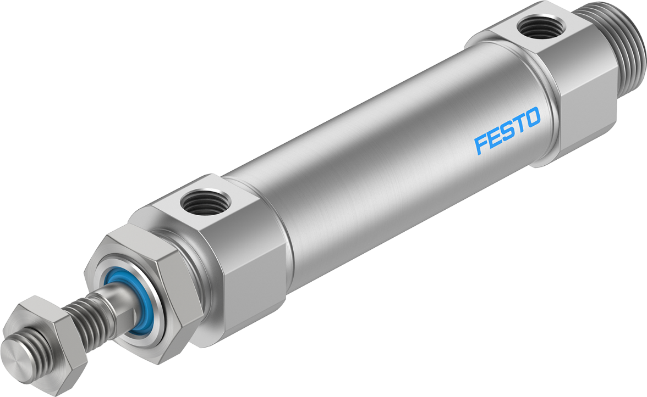
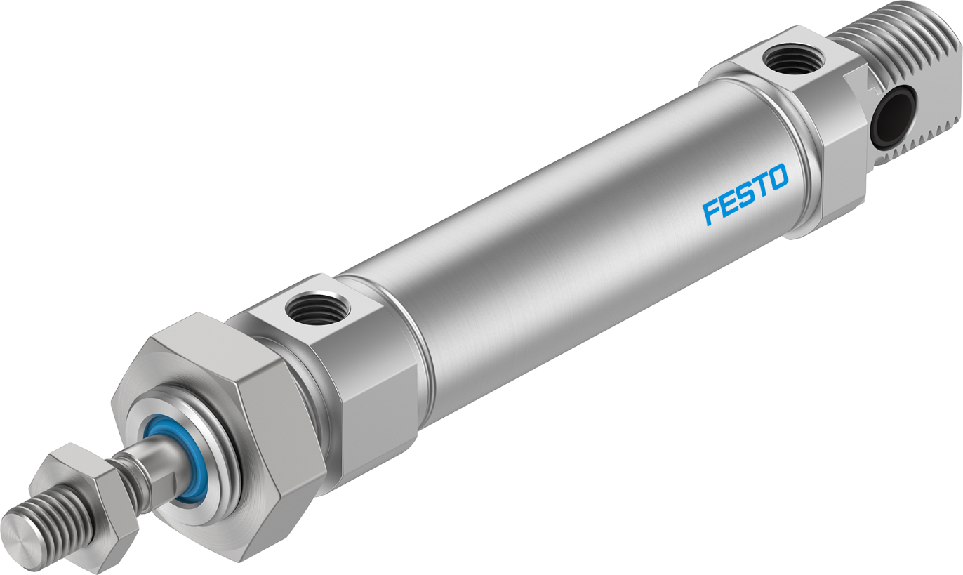
Slim and self-adjusting
DSNU-S-...
∅ 8 ... 16
Round cylinders DSNU, ESNU and DSNU-S
DSNU-S-...
∅ 20/25
DSNU
(ISO)
(ISO)

Slide 3
Slim and self-adjusting
DSNU-S-...
∅ 8 ... 16
Round cylinders DSNU, ESNU and DSNU-S
Agenda:
Brief overview of the drive
Find out about solutions for your requirements
DSNU-S-...
∅ 20/25
DSNU
(ISO)
(ISO)

Slide 4
Slim and self-adjusting
DSNU-S-...
∅ 8 ... 16
Round cylinders DSNU, ESNU and DSNU-S
Best performance
proven reliability of the DSNU, ESNU series
Extremely versatile
thanks to optional variants in the modular system for the DSNU, ESNU
Minimal space requirement
New space-optimised series DSNU-S
Extremely easy and time-saving installation
With self-adjusting cushioning PPS
Extremely economical
Thanks to attractive price and long service life
Easily available
Short delivery times and worldwide availability of the Core Range
DSNU-S-...
∅ 20/25
DSNU
(ISO)
(ISO)

Slide 5



Pneumatic round cylinder
DSNU, ESNU (ISO)
DSNU-S (space-saving)
Update
2021
Since July 2020
For use in any application, standardised (ISO 6432)
Reliable design principles for over 30 years
Wide range of applications and variants
Up to 35 mm shorter
Up to -40% slimmer
Designed for direct mounting in space-critical applications

Slide 6

DSNU, ESNU ISO variants – Product relaunch
Spanner flats
for easy installation
Updates from 2021
Polymer bearing for pivoting
Smooth running and low wear
Sensing option using the new self-adjusting proximity sensor SDBT-MSX with auto teach-in function
PUR seals
Low wear
Label with Product Key
Permanent digital product identification
Tried-and-tested materials
Piston, piston rod, seals, bearings, grease
Same mounting surfaces
Same technical features
➔ Dimensional changes
Continuation of usual part numbers and type codes

Slide 7
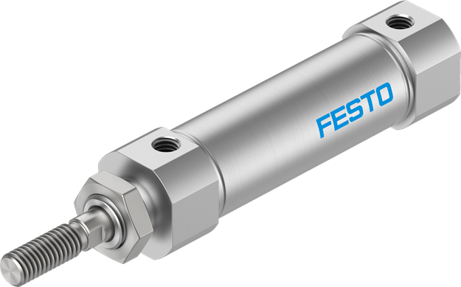
New possibilities of the space-saving DSNU-S
Proximity sensor SDBT-MSX
with auto teach-in
Smallest space requirements for your machine design
Up to 40% slimmer
Up to 35 mm shorter than DSNU ISO variants
→ Unbeatable in tight conditions
Lightweight
Easy to assemble, even when things are tight
Self-adjusting cushioning above Ø 16
Self-adjusting proximity sensor SDBT-MSX
→ It doesn’t get any faster
Optimised dimensions
DSNU-S
Self-adjusting
pneumatic cushioning PPS
Copper-free variant available
Usage for battery production

Slide 8
Delivery time
Availability
Features
Tips and tricks
Your
requirements?
Warehousing
Functions
Product service life
Maintenance
Applications

Slide 9
Topics
Motivation
Features
Dimensions
Interfaces
Sustainability
Application
DSNU-S-...
∅ 8 ... 16
Features
Dimensions
DSNU
(ISO)
DSNU-S-...
∅ 20/25
Comparison:
Features
Forces
Technical data
Accessories
PPS cushioning
Overview

Slide 10
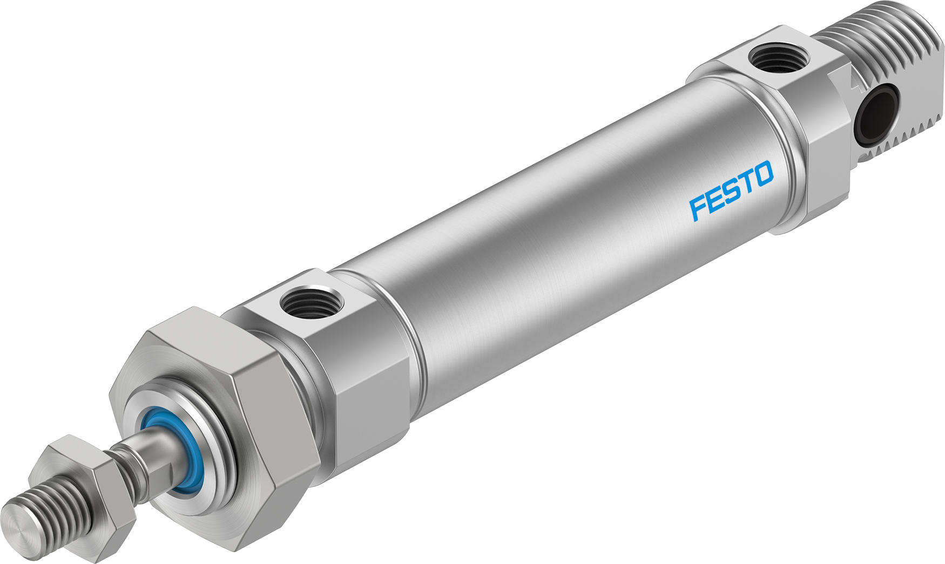
Features
Piston with integrated elastic cushioning element
Standard with all cushioning variants
Reduced effort for noise reduction
Robust for max. impact force
High performance also with higher loads and speeds
Economical by long lifetime
Self-adjusting pneumatic cushioning PPS
Easy installation
Time saving
Reduced space requirements w/o screw
Tamper-proof
DSNU (ISO)
Polymer bearing for pivoting
Standard for all sizes
Reduced wear
Economical by long lifetime
Piston with magnet for sensing standard
Easy product selection and stock handling
Usage of new self-adjusting cylinder switch SDBT-MSX
Label with product-key
Unique product identification
Service for customer and logistics, re-ordering and traceability
Seal for piston rod and piston made of PUR
Wear resistant
Economical by long lifetime
Piston rod made of stainless steel
Corrosion and wear resistant to prevent leakage
Economical by long lifetime
Barrel made of stainless steel
Sturdy design
Economical by long lifetime
Variety of optional modular kit types
Perfect fit to the surroundings
Easy ordering of serial products
Global availability by known order channels
Rod bearing made of sintered metal
Robust performance with lateral loads, long strokes and applied moment with pivoting
Economical by long lifetime

Slide 11
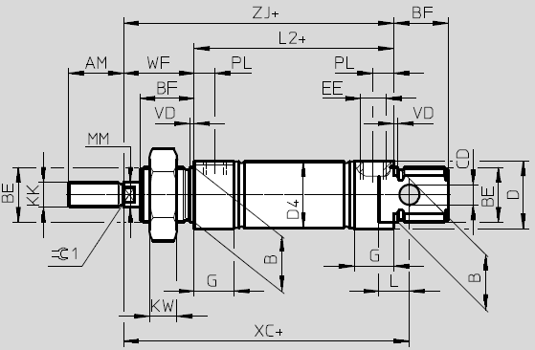
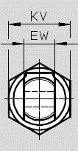
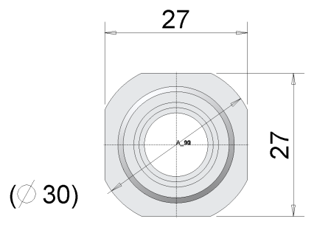
Dimensions
Compatibility comparison
DSNU (old)
DSNU (ISO)
Ø | 8 | 10 | 12 | 16 | 20 | 25 | 32 | 40 | 8 | 10 | 12 | 16 | 20 | 25 | 32 | 40
AM | 12 |  | 16 |  | 20 | 22 | 22 | 24 | 12 |  | 16 |  | 20 | 22 | 22 | 24
WF | 16 |  | 22 |  | 24 | 28 | 34 | 39 | 16 |  | 22 |  | 24 | 28 | 34 | 39
BF | 12 |  | 17 |  | 20 | 22 | 26 | 30 | 12 |  | 17 |  | 20 | 22 | 26 | 30
H | 28 |  | 38 |  | 44 | 50 | 56 | 63 | 28 |  | 38 |  | 44 | 50 | 56 | 63
L2+ | 46 |  | 50 | 56 | 68 | 69.5 | 69.5 | 84.6 | 46 |  | 50 | 56 | 68 | 69.5 | 69.5 | 84.6
ZJ+ | 62 |  | 72 | 78 | 92 | 97.5 | 103.5 | 123.6 | 62 |  | 72 | 78 | 92 | 97.5 | 103.5 | 123.6
XC+ | 64 |  | 75 | 82 | 95 | 104 | 117.5 | 139.6 | 64 |  | 75 | 82 | 95 | 104 | 117.5 | 139.6
D1 | 15 |  | 20 |  | 27 | 27 | 38 | 46 | 14 |  | 18 |  | 26 | 27 | 38 | 45
D | 15 |  | 20 |  | 27 |  | 38 | 46 | 16 |  | 20 |  | 30 |  | 41 | 49
KV | 19 |  | 24 |  | 32 | 32 |  |  | 19 |  | 24 |  | 32 | 32
KK | M4 |  | M6 |  | M8 | M10 x1.25 | M10 x1.25 | M12 x1.25 | M4 |  | M6 |  | M8 | M10 x1.25 | M10 x1.25 | M12 x1.25
BE | M12x1.25 |  | M16x1.5 |  | M22x1.5 |  | M30 x1.5 | M38 x1.5 | M12x1.25 |  | M16x1.5 |  | M22x1.5 |  | M30 x1.5 | M38 x1.5
EE | M5 |  |  |  | G1/8 |  |  | G1/4 | M5 |  |  |  | G1/8 |  |  | G1/4
-P | 5,5 |  | 7 |  | 9,5 | 8,5 | 13 | 15 | 5 |  | 6 |  | 9 | 8,5 | 13 | 14,5
H
Width D1
Height D1
Diagonal
Ø D
Max. depth of air supply connection (-P)

Slide 12
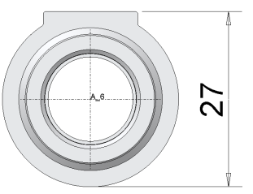
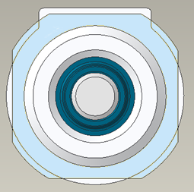
Applications
Comparison of end caps DSNU (ISO)
Deltas in the space required for the new design
Old DSNU
Width = diagonal
Ø | Width = Height = D1 | Diagonal D | Max. depth of air supply connection | Design
8 | - 1 mm | + 1 mm | - 0,5 mm | New design
10 | - 1 mm | + 1 mm | - 0,5 mm
12 | - 2 mm | 0 | - 1 mm
16 | - 2 mm | 0 | - 1 mm
20 | - 1 mm | + 3 mm | - 0,5 mm
25 | 0 | + 3 mm | 0
32 | 0 | + 3 mm | 0
40 | - 1 mm | + 3 mm | - 0,5 mm
50 | 0 | 0 | 0 | Old design
63 | 0 | 0 | 0
= height
DSNU (ISO)
Width
Max. depth
Air supply connection
Height
Diagonal

Slide 13
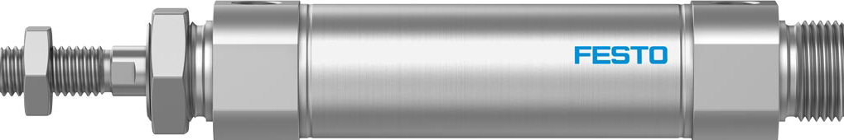
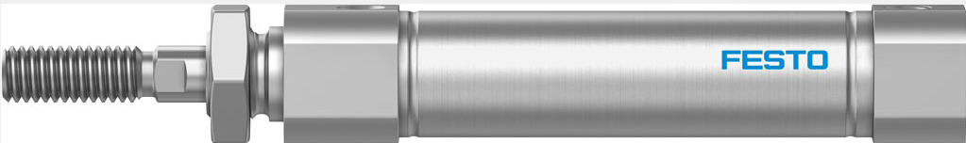
Motivation
DSNU-S-...
Space-optimised design
Attractively priced
Extended portfolio for round cylinders

Slide 14
Features
Piston with integrated elastic cushioning element
Standard with all cushioning variants
Reduced effort for noise reduction
Robust for max. impact force
High performance also with higher loads and speeds
Economical by long lifetime
Self-adjusting pneumatic cushioning PPS
Easy installation
Time saving
Reduced space requirements w/o screw
Tamper-proof
DSNU-S-... space optimized
Without pivot bearing and without mounting thread for bore size 8/12/16
Short end cap
Economical by minimized space requirement
Piston with magnet for sensing standard
Easy product selection and stock handling
Usage of new self-adjusting cylinder switch SDBT-MSX
Seal for piston rod and piston made of PUR
Wear resistant
Economical by long lifetime
Label with product-key
Unique product identification
Service for customer and logistics, re-ordering and traceability
Piston rod made of stainless steel
Corrosion and wear resistant to prevent leakage
Economical by long lifetime
Barrel made of stainless steel
Sturdy design
Economical by long lifetime
Free of copper
Usage for battery production
No emisson of unwanted particles
Quality of production
Without separate piston rod bearing
Slim design for mounting thread at bearing cap
Economical by minimized space requirement

Slide 15
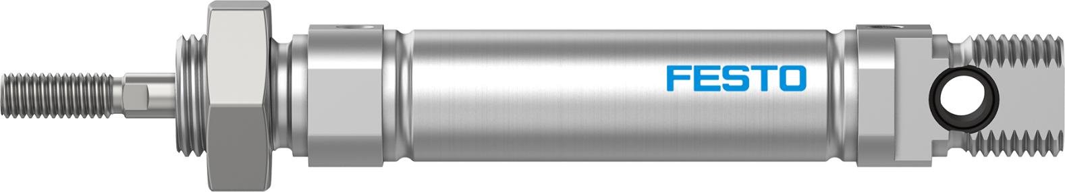
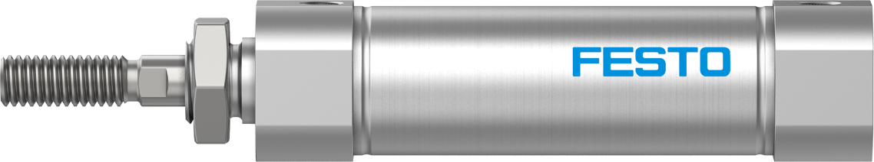
The new way of saving space with the DSNU-S
DSNU to ISO 6432
Standardised interfaces for easy connection
Wide range of variants for greater flexibility
DSNU-S space-saving
For tight installation spaces
Enables a sustainable machine design and an energy-saving layout for handling units
Up to 40%
slimmer
Up to 35 mm shorter
Same nominal diameter and stroke length
Shown here: DSNU/-S-16-25-P-A

Slide 16
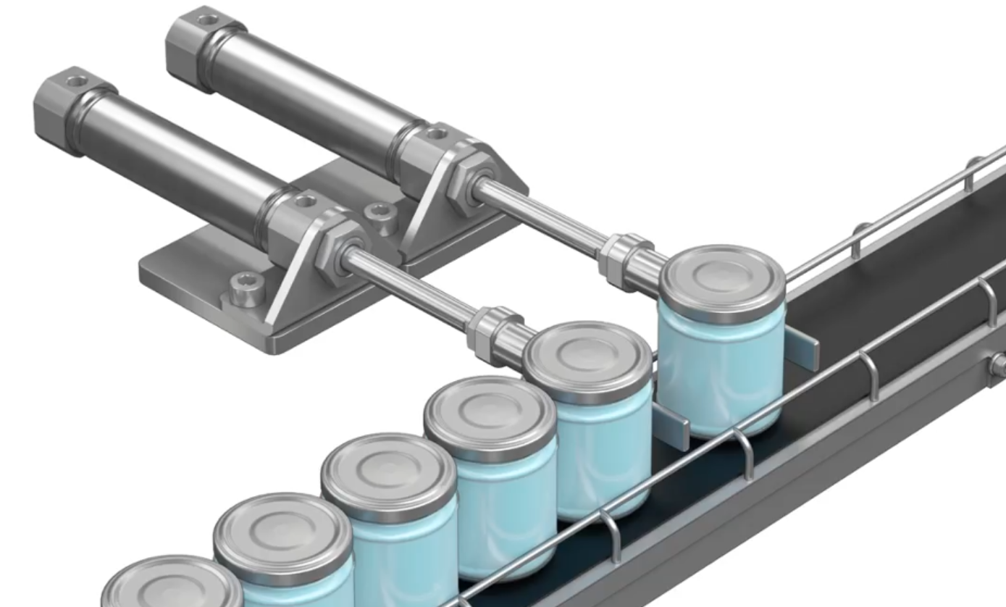
Application example for parallel mounting
DSNU-S space-saving
Parallel mounting for separating workpieces at buffer sections
Features:
For simple linear movements
For small to medium strokes
For low transverse loads
For handling small workpieces
For limited installation space in terms of width
(mounted in parallel)
➔Video @ Content Hub #144896

Slide 17
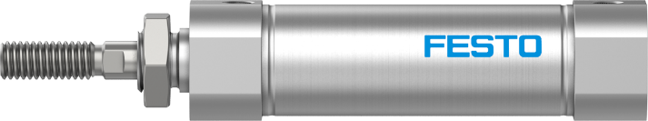
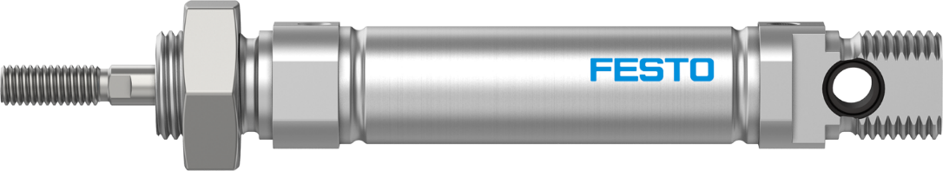
Pneumatic round cylinder for durable and compact machine design
Up to 50% lighter
Reduced weight
Lower moving mass
Energy-efficient handling

Slide 18

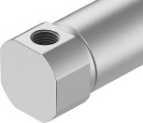
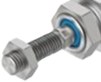
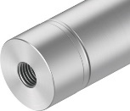
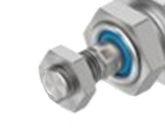
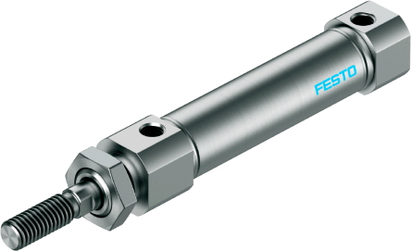
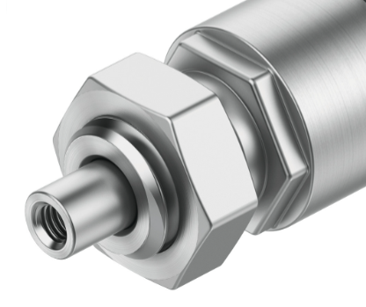
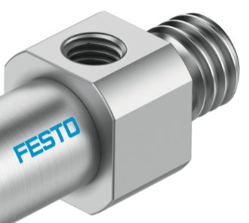
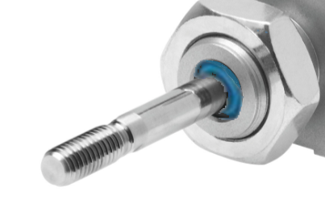
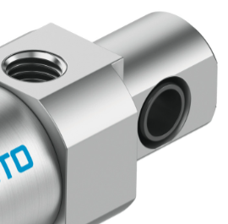
An interface for every eventuality
DSNU-S-...
with multiple interfaces
MQ
K2
Piston rod thread
K2 – extended
K6 – shortened
K3 – with female thread
End cap
MQ - short with
lateral supply port
K6
MA - with axial supply port
MA
Piston rod
K8 – extended
MX - with
mounting thread
K3
MX
MP - with swivelling rod eye
K8
Simply part of the solution
MP

Slide 19
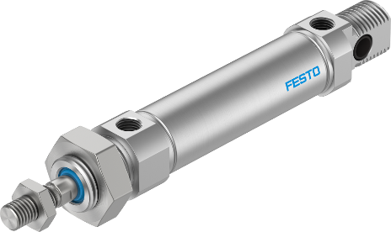
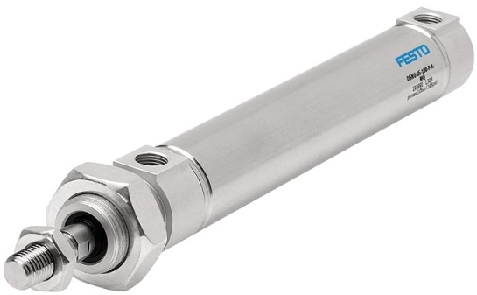
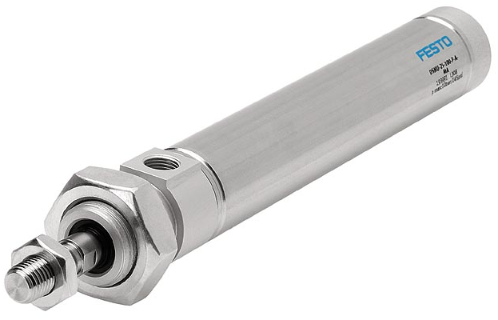
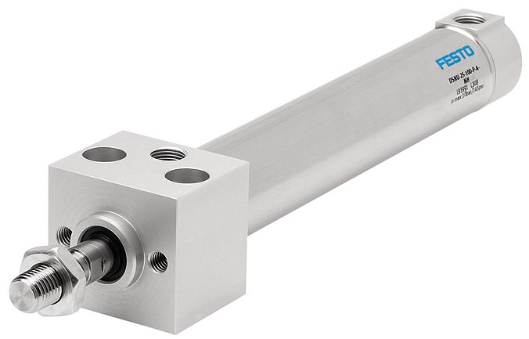
DSNU, ESNU ISO types
Wide choice of variants and features
Square piston rod (protection against rotation)
Through piston rod
Heat-resistant seals up to 120 °C
Corrosion resistant with NSF-H1 grease
From 2021: FPM seal for increased chemical resistance
Extended male piston rod thread
Female piston rod thread
Special thread on the piston rod
Piston rod with male thread shortened at one end
Extended piston rod
From 2021: Low friction
Constant motion (at low piston speeds)
Clamping unit on the piston rod
ATEX II 2GD compliant
Dust protection (seal with scraper) 32… 63 mm
Metal scraper 32 … 63 mm
ESNU single-acting
Standard
MQ
Short cylinder end cap
with lateral supply port
MA
Axial
supply port
MH
Direct mounting on the bearing cap
Short end cap with lateral supply port

Slide 20
Sustainable development
Conserving resources
DSNU-S-...
up to 35 mm shorter
up to 40% slimmer
Less material consumption
Faster switching
Easier to operate
Less moving weight
Less weight
Less storage space
Less space required
More efficient warehousing
More compact designs
Simply part of our future range

Slide 21
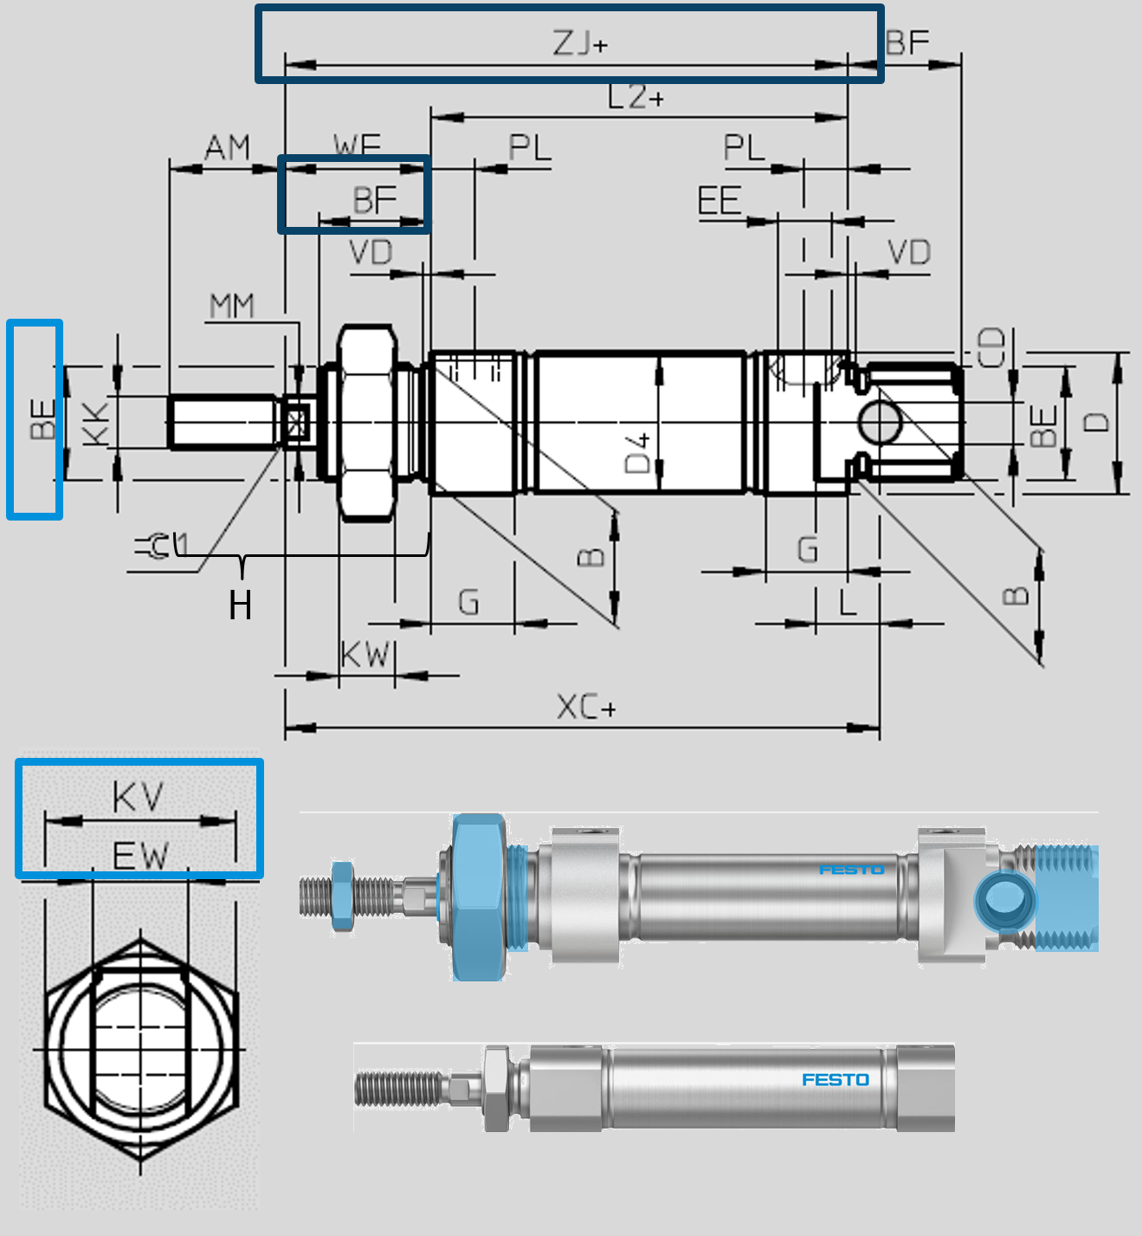
Dimensions
DSNU-S-...
DSNU (ISO)
DSNU-S-... compared to DSNU (ISO)
Ø | 8 | 12 | 16 P | 16 PPS | 20 | 25 | 8 | 10 | 12 | 16 | 20 | 25
AM | 12 | 16 | 16 |  | 20 | 22 | 12 |  | 16 |  | 20 | 22
WF | 12 | 13 | 13 |  | 17 | 20 | 16 |  | 22 |  | 24 | 28
BF | 8 | 8 | 8 |  | 13 | 13 | 12 |  | 17 |  | 20 | 22
H | 24 | 29 | 29 |  | 37 | 42 | 28 |  | 38 |  | 44 | 50
L2+ | 45 | 46 | 46 | 57 | 58 | 61 | 46 |  | 50 | 56 | 68 | 69.5
ZJ+ | 58 | 59 | 60 | 70 | 76 | 81 | 62 |  | 72 | 78 | 92 | 97.5
D | 12 | 14 | 18 |  | 24 | 27 | 14 |  | 18 |  | 26 | 27
KV | 11 | 14 | 14 |  | 26 | 26 | 19 |  | 24 |  | 32 | 32
KK | M4 | M6 | M6 |  | M8 | M10 | M4 |  | M6 |  | M8 | M10
BE | M8 | M10 | M10 |  | M20 | M20 | M12x1.25 |  | M16x1.5 |  | M22x1.5
EE | M5 |  |  |  | G1/8 |  | M5 |  |  |  | G1/8
-P | 4 | 4 | 6 |  | 8 | 8,5 | 5 |  | 6 |  | 9 | 8,5
Max. depth of air supply connection (-P)

Slide 22
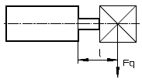
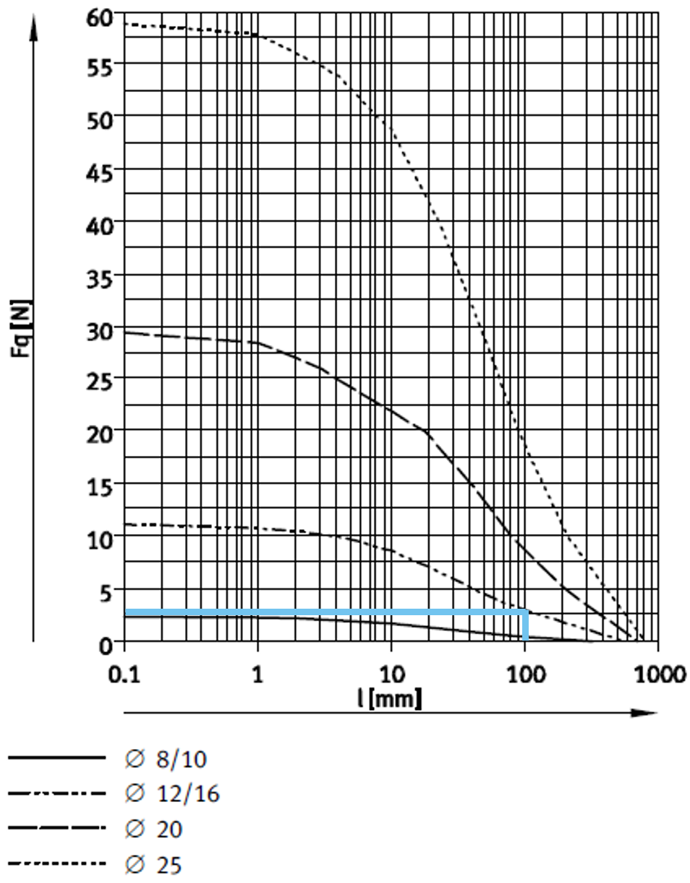
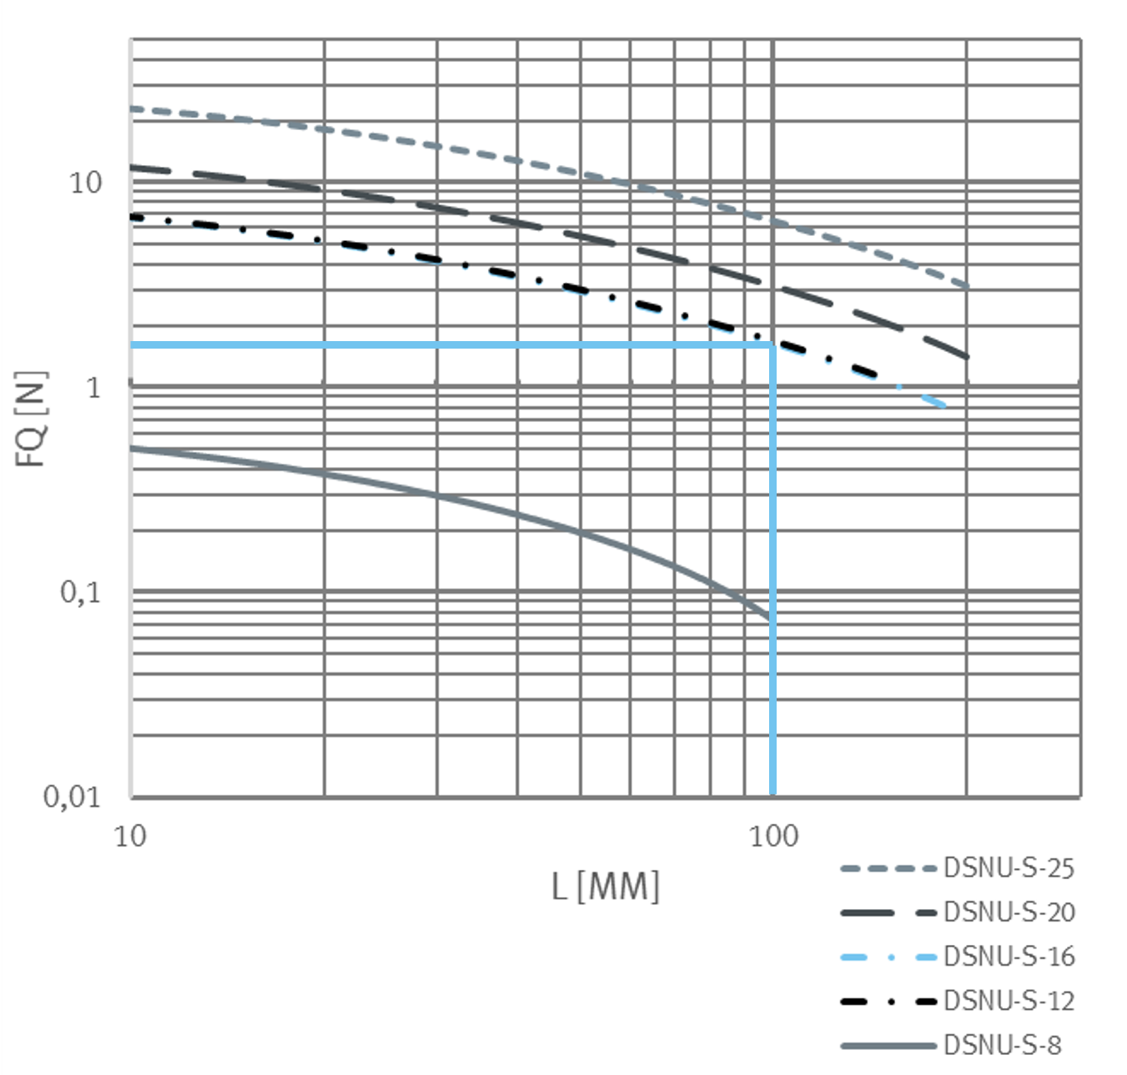
Forces
DSNU-16 (ISO)
DSNU-S-16
Allowable lateral load
Allowable lateral load

Slide 23
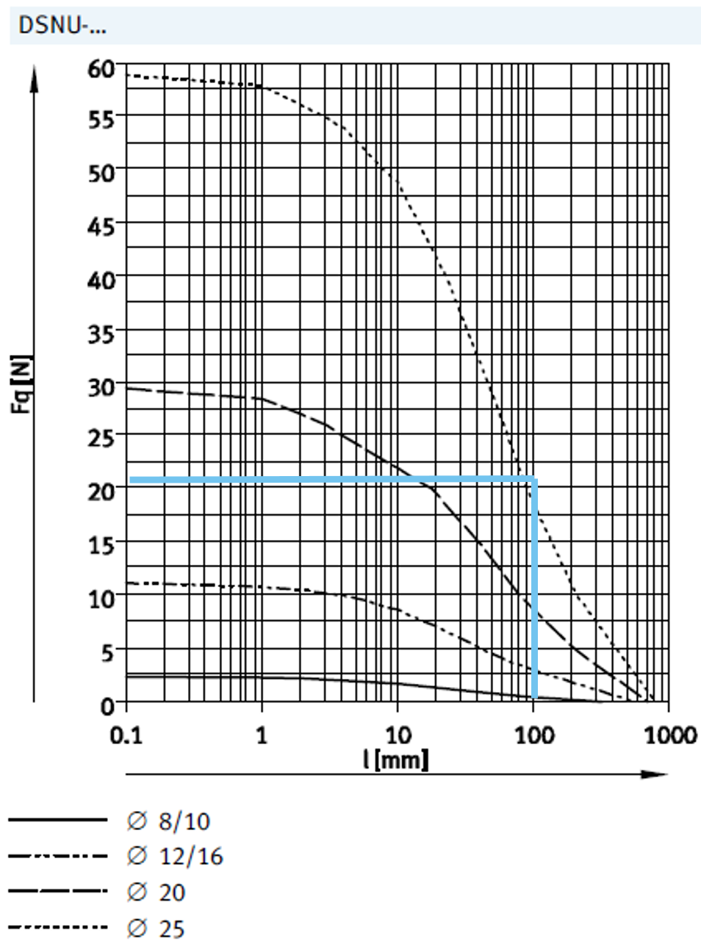
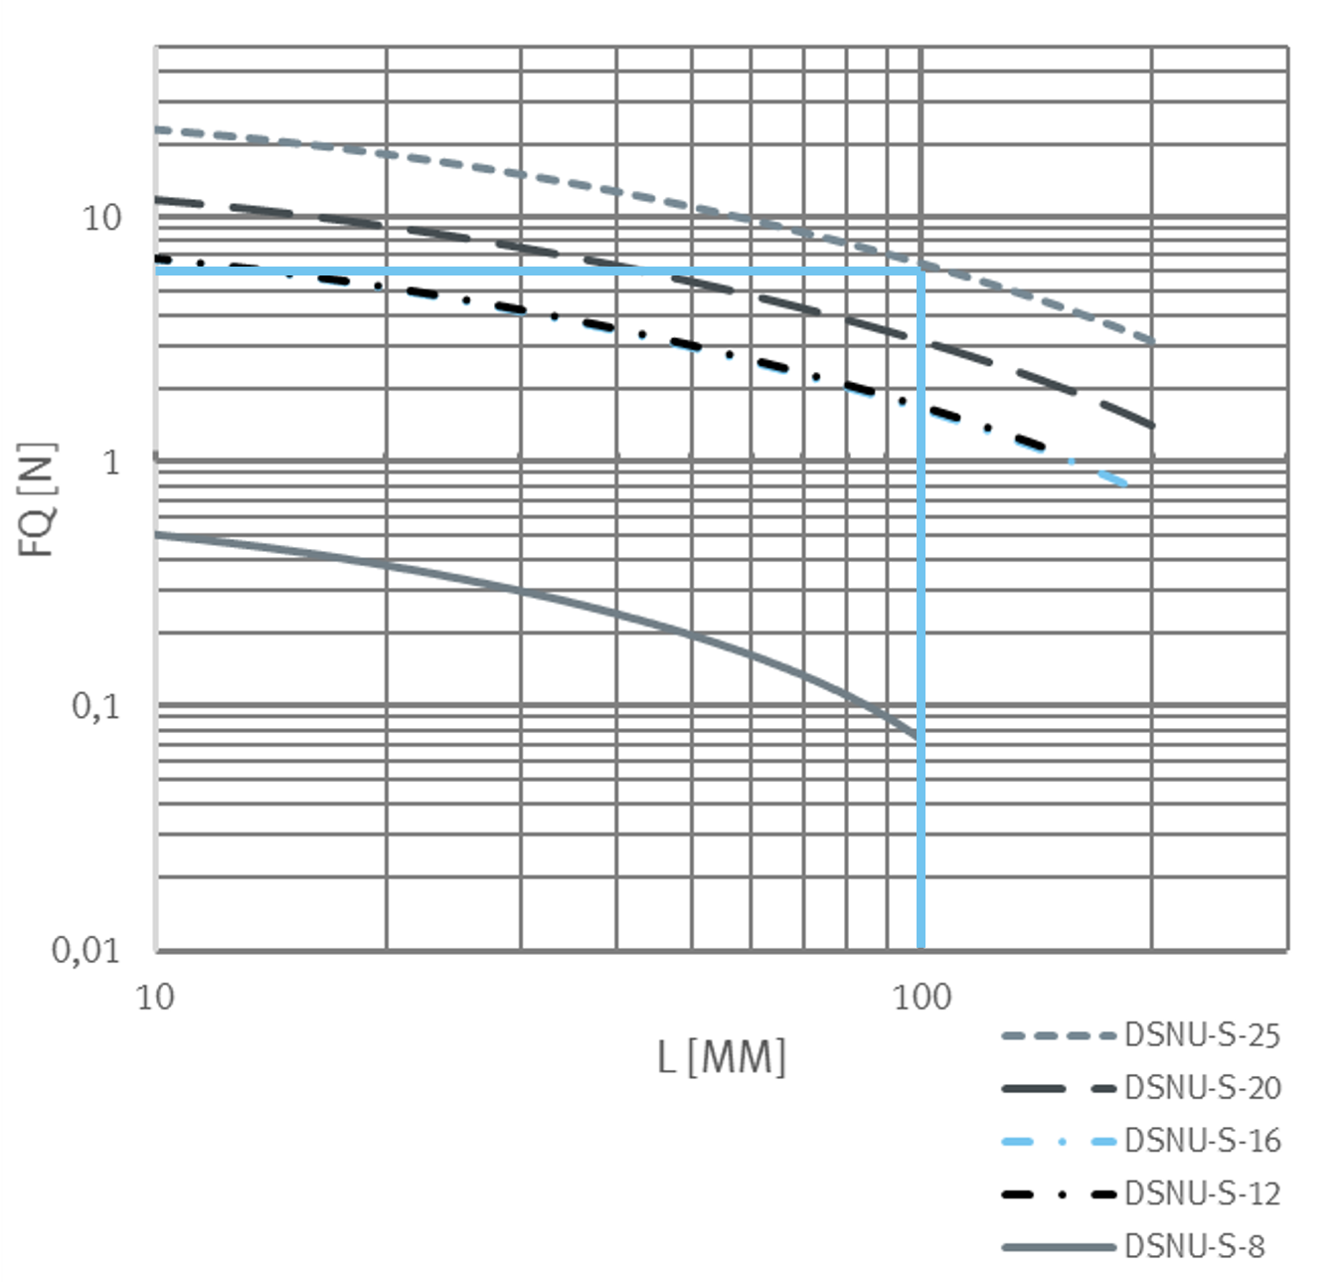
Forces
DSNU-25 (ISO)
DSNU-S-25
Allowable lateral load
Allowable lateral load

Slide 24
Technical data
General selection
Nominal size
Max. standard strokes
Max. intermediate strokes
Cushioning
Magnet for position measurement
Mounting thread on bearing cap
Mounting thread on end cap
Pivot device on end cap
Modular system variants
DSNU-S-...
8/12/16/20/25
200 mm
200 mm
P/PPS
Standard
All Ø
For Ø 20/25
Not possible
Not possible
DSNU (ISO)
8/10/12/16/20/25/32/40/50/63
500 mm
500 mm (longer on request, up to 2,000 mm)
P/PPS/PPV
Standard
All Ø
All Ø
Incl. pivoting for all Ø
Available

Slide 25
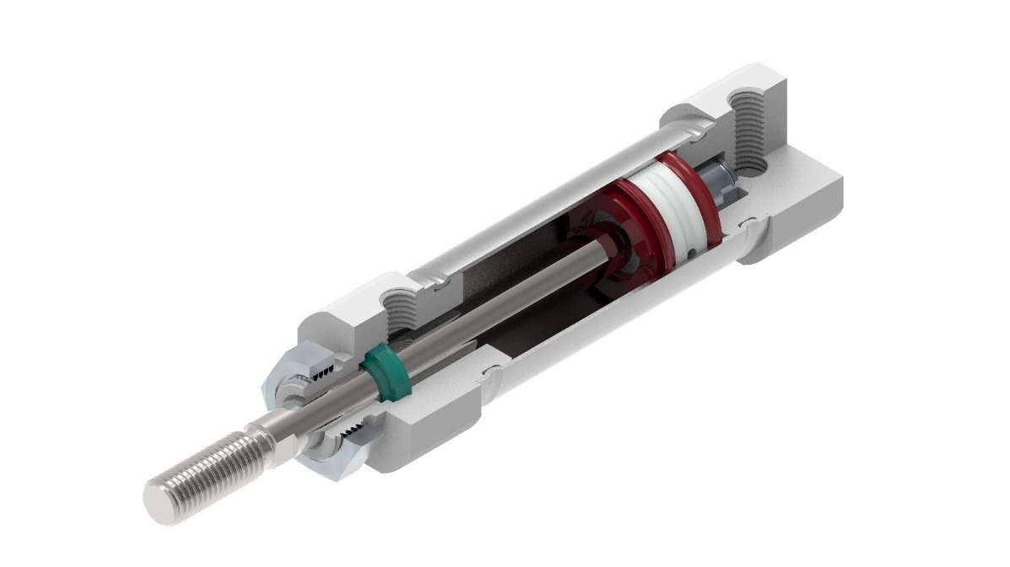
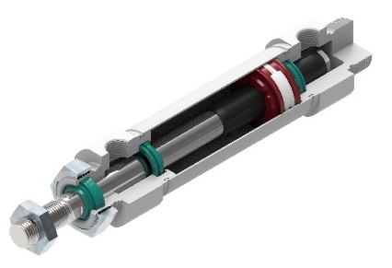
Features
Shorter end caps
Without hole for swivel bearing
Ø 20/25 with threat as standard
Cylinder in total ~2,5 cm shorter than DSNU
DSNU-S-16-P 1 cm shorter than DSNU-S-16-PPS
DSNU-S-20/25-P same length as -PPS
Air supply port
Same types M5 and G1/8
~1mm less deep
DSNU-S-... compared to new DSNU (ISO)
Available sizes
Ø 8, 12, 16, 20, 25
Without Ø 10
Same P and PPS cushioning
No PPV available
Even thinner
Caps about -3 mm more flat than new DSNU
Smaller mounting threads and nuts (up to -40%)
Same PUR piston rod seal
Ø 8…16 behind bearing
Ø 20/25 in front of bearing
Without separate bearing
Free of copper
Reduced max. lateral load
Smaller mounting threat size for min. total width
Same rolling connection
Same look
Same piston
Magnet and elastic damping standard
Same max. energy
Same piston rod
Stainless steel
Same barrel
Stainless steel
Different mounting interfaces
Smaller threads
Not interchangeable
Same grease
PWIS free
Same material for end caps
Anodized aluminium
Ø 20/25-PPS
Less space requirement with focused usage on direct mounting

Slide 26
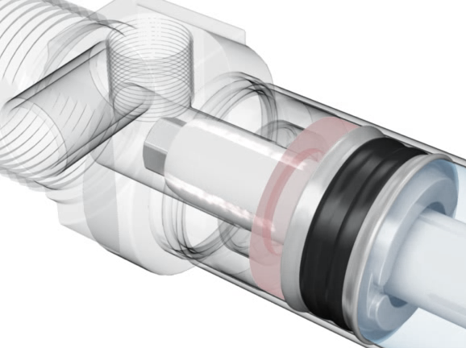
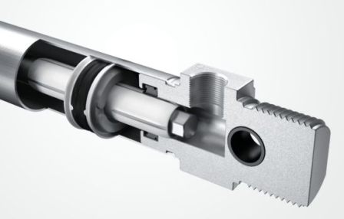

Simply better with self-adjusting cushioning PPS
Effective pneumatic cushioning
Longitudinal slots ( )
allow the air ( ) to escape,
permitting dynamic, gentle movement into the end position
Self-adjusting without adjusting screw
= Space-saving with no access required
= Quick commissioning
= Tamper-proof
…
Animation
  26

Slide 27
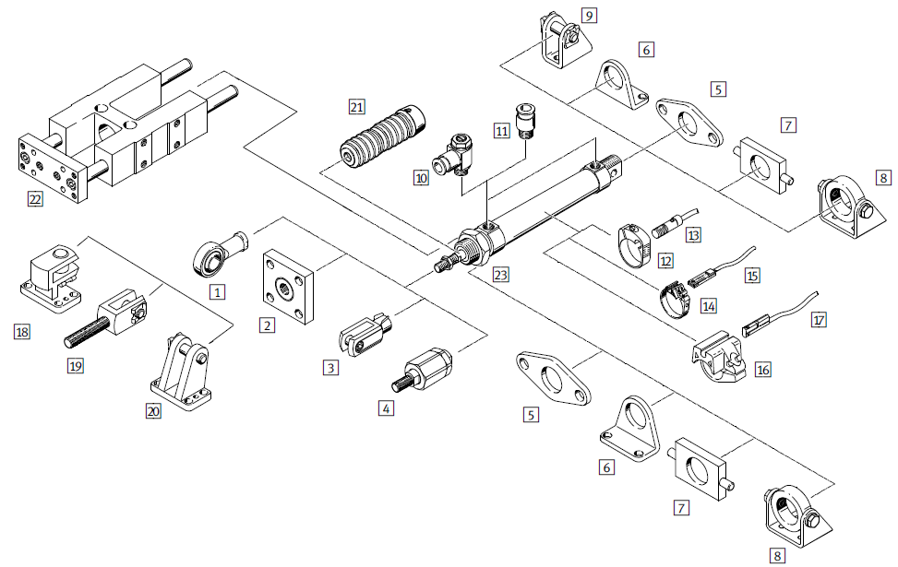
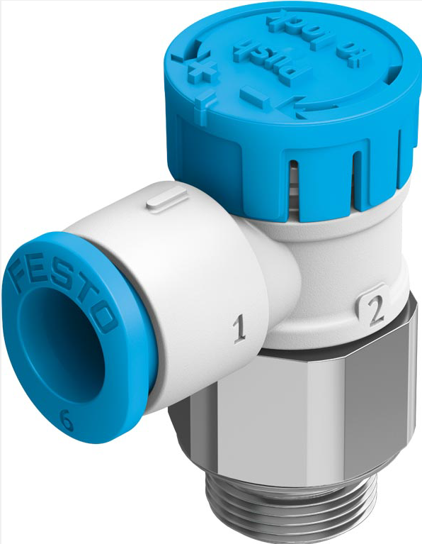
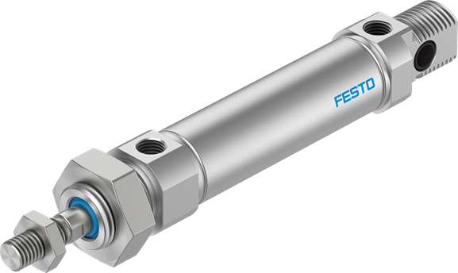
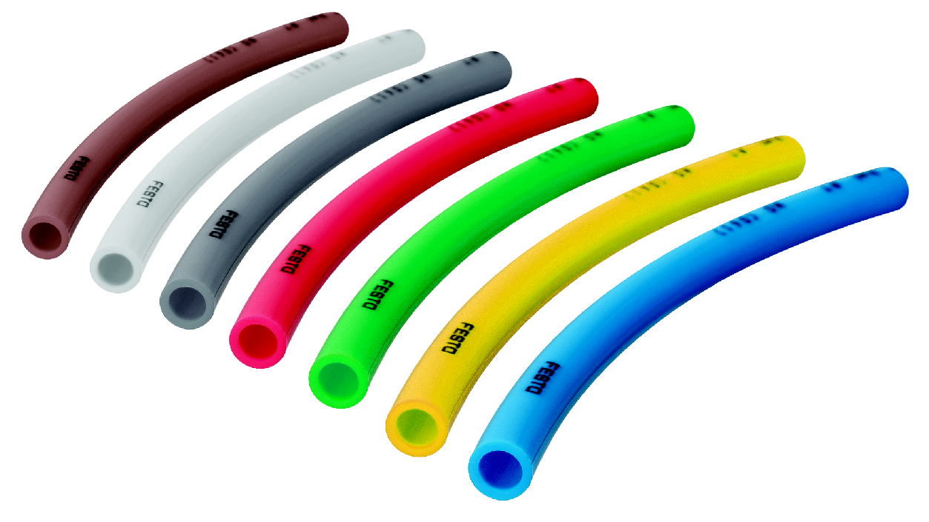
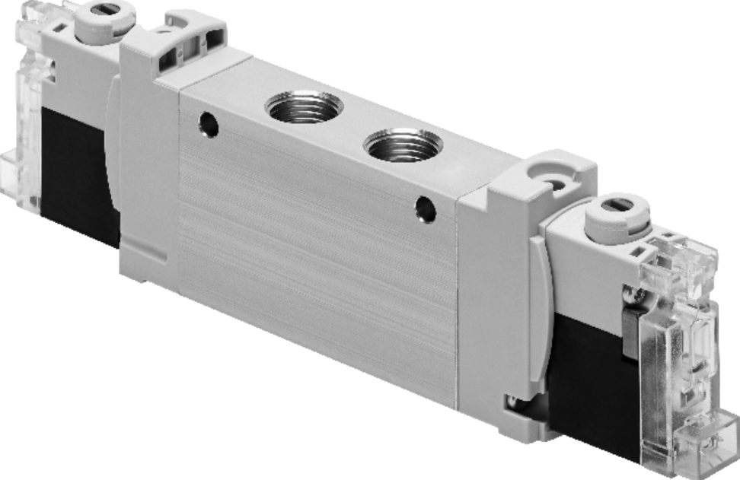
Accessories
Useful peripherals
SDBT-MSX
VFOE
PUN-H
VUVG-...-S
Further use of accessories of the DSNU

Slide 28
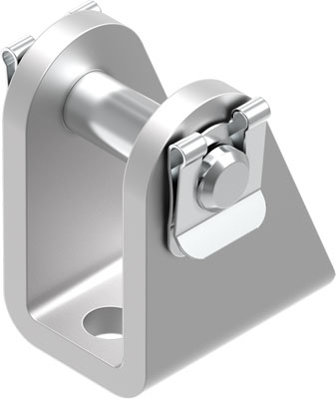
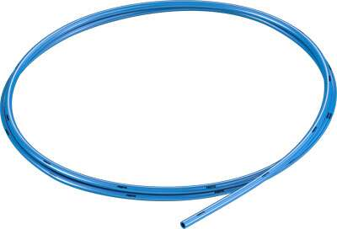
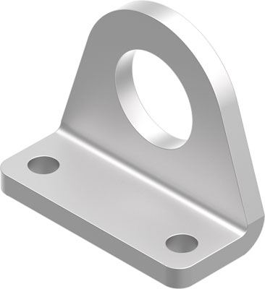
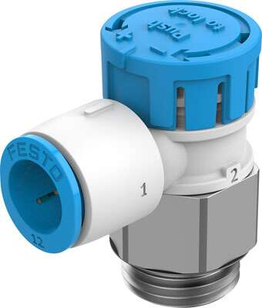

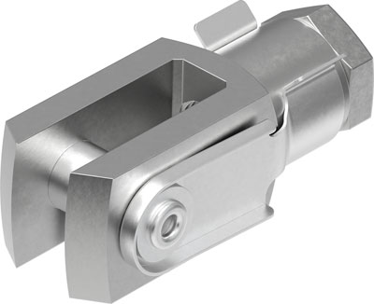






Wide selection of accessories in the Core Range
Tubing
e.g. PUN-H
Clevis foot (LBN)
Fitting and one-way flow control valve
e.g. VFOE
Foot mounting
(HBN-S)
Rod clevis
(SG)
Mounting component
(SMBR-8-)
Rod eye
(SGS)
Proximity switch
e.g. SDBT-MSX
Self-aligning rod coupler (FK)
Proximity switch
e.g. SMT-8M-A
Coupling piece (KSG)
Core Range products Quickly available worldwide

Slide 29




Engineering tools to ease your workload
DSNU-S
From the Festo Core Range - quickly available worldwide
→ Simply order on the Online Portal
Quick access to CAD data
@PARTdataManager
Easy to select accessories
@Festo Design Tool FDT
Pneumatic simulation
Simulation of the complete pneumatic chain
PN 8155045

Slide 30



Overview
DSNU (ISO), ESNU (ISO), DSNU-S-...
 |  | Nominal size | Strokes | Cushioning | Magnet | Variants
Stays the same | DSNU (ISO) | Ø 12…40 | 10…320 mm (standard strokes) | P PPS from Ø 16 PPV from Ø 16 | Standard | None
 | DSNU (ISO) ESNU (ISO) | Ø 8…63 Production goods and goods for resale Ø 8/10/50/63 | 1…500 mm (longer on request) | P PPS from Ø 16 PPV from Ø 12 | Standard | X-strokes Modular kit (S2, S6, Q, R3, ATEX, etc.)
New | DSNU-S-... | Ø 8/12/16 Ø 20/25 | 10…200 mm (standard strokes) | P PPS from Ø 16 | Standard | None
 | DSNU-S-... | Ø 8…25 | 1…200 mm | P PPS from Ø 16 | Standard | X-strokes
★
★

Slide 31
Navigator
DSNU dimensions
DSNU-S dimensions
DSNU features
DSNU-S features
DSNU-S motivation
DSNU-S Interfaces
DSNU-S Sustainability
DSNU-S Application
Accessories
Features
Forces
Overview
PPS cushioning
Technical data

