Slide 1
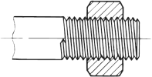

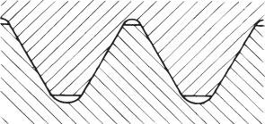
Typical fitting thread types
Exit
How to differentiate thread types?
M
NPT
BSP
BSPP
BSPT
G
R(p)
UNF
Parallel OR
taper thread (angle°)
?
?
?
Flank curve
Female thread
(e.g. screw-nut)
Thread angle
?
?
60°
Outer diameter
?
?
Effective diameter
?
Core diameter
Core rounding
Male thread
(e.g. bolt)
Pitch
1

Slide 2
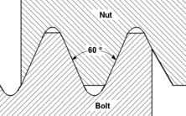
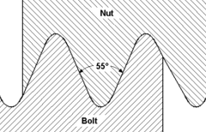
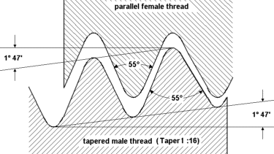



Typical fitting thread types – “Metric threads”
Exit
M - Metric | G – British Standard Pipe Parallel (BSPP) | R(p) – British Standard Pipe Tapered (BSPT)
DIN ISO 965-1 | ISO 228-1 | DIN EN 10226-1
Threads are made pressure tight by compressing an appropriate seal between two tightening surfaces (shoulder seal) located outside the thread area Thread is for holding power only This thread type consists of parallel internal and parallel external designs |  | Threads are made pressure tight by using the threads (wedging) to make a pressure tight seal This thread type consists of taper external and parallel internal designs Note: An “R” male thread can also be used with parallel female “G” threads
Shoulder
Shoulder
Parallel
Parallel
Tapered threads with Teflon sealant

Slide 3
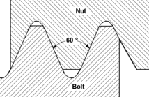
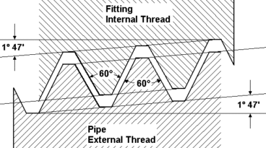
Typical fitting thread types – “Inch threads”
Exit
UNF – Unified National Fine Thread | NPT – National Pipe Thread
ANSI B 1.1 | ANSI B 1.20.1
Threads are made pressure tight by compressing an appropriate seal between two tightening surfaces (shoulder seal) located outside the thread area Thread is for holding power only This thread type consists of parallel internal and parallel external designs | Threads are made pressure tight by using the threads to make a pressure tight seal (wedging) This thread type consists of taper external and taper internal designs
Shoulder
Parallel
Tapered threads with Teflon sealant

Slide 4


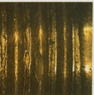
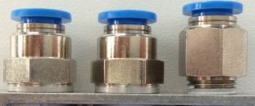
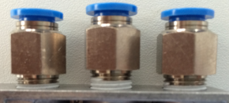
Safe energy by using G-thread fittings
Exit
Features of G-thread fittings | Advantage against R- and NPT-thread fittings | Benefit for the customer
It’s possible to define a tightening torque. | While tightening a R-thread fitting you have to take a rule of thumb to find the point, where no leakage is occurred. Therefore the probability, that there is no leakage after tightening the fitting, is higher by using a G-thread fitting. | Reducing of energy costs Easier to install Saving time during tightening Reliability, that there is no leakage
The G-thread fitting seals, contrary to R-thread fittings, with an additional sealing ring. | Irregularities on the thread can be disregarded by using G-thread fittings. | Reliability, that there is no leakage
The screw-in depth don’t differ. | If you tighten a couple of fittings in a row, all have the same height. | Looks better in the eye of a customer
It´s possible to screw a G-thread fitting in polymer. | By using a R-thread fitting in this case, the fitting could destroy the female polymer thread. | Avoiding of damages
Multiply using of G-thread fittings. | A R-thread fitting can only be used 4-5 times. | After several times of un-installing a G-thread fitting, it‘s anyway possible to use it again

