Slide 1
Table of contents
Exit
Fittings overview
Plastic fittings
QS fittings
QS-V0 Fittings
NPQP polypropylene fitting
NPKA Polymer click fitting
Metal fittings
NPQH Metal fitting
NPQM metal fitting
NPCK Clean Design stainless steel fitting
CRQS Stainless steel fitting
NPFC Threaded fitting

Slide 2
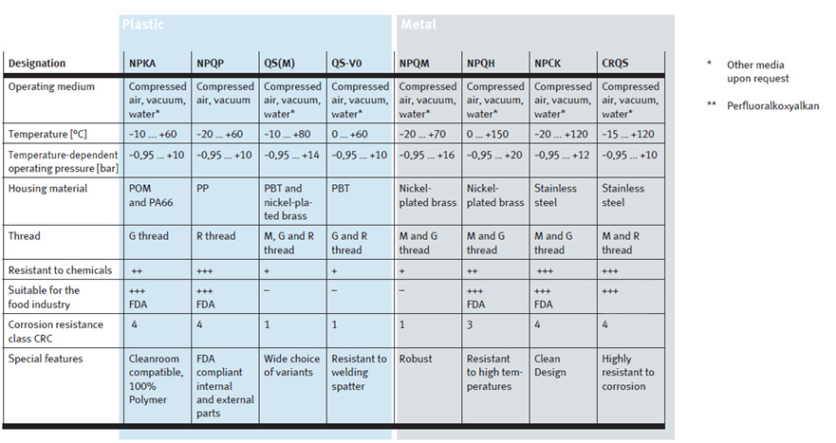
Fittings overview
Exit
Back

Slide 3
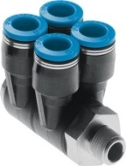
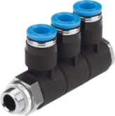
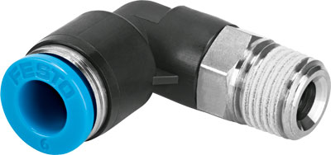
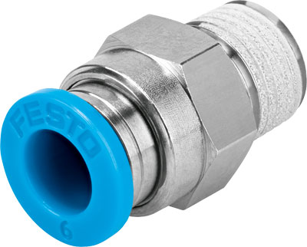
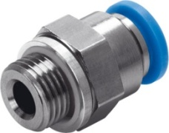
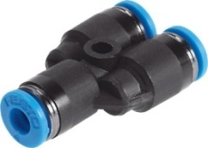
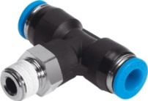
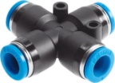
QS fittings
Exit
Back
Range of applications
Standard applications
Features
Sizes M3 … 3/4“
Tubing connector Ø3 … Ø22
Wide range of products
Pressure- and temperature range
Temperature dependent operating pressure:
-0,95 … 14 bar
Ambient temperature:
-10°C … +80°C

Slide 4
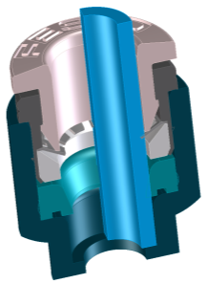
4 product details of the QS are making the difference
Exit
Back
Product detail | Feature | Benefit
 | Optimized size that makes easy to push on it and release the tube No axial movement while switching on and of the pressure | Convenience Safety Reliability
 | Because of the special designed claw: Highest clamping forces (higher than burst pressure of most common tubes) Lowest tube inserting force for an easy and quick installation | Safety Performance Reliability Convenience
 | Guarantees that the tube has no kink at the place of the sealing lip. It avoids leakage | Profitability Reliability Performance
 | Lowest tube inserting and releasing force for an easy and quick de-/installation Compensation of little grooves on the tubing surface to avoid leakage and thus reducing of energy costs No leakage with vacuum applications because of the special sealing lip design | Convenience Reliability Performance Profitability
Release ring
Clamping disc
Distance ring
Sealing lip

Slide 5
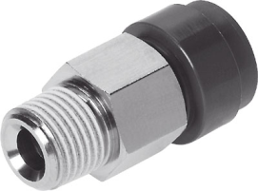
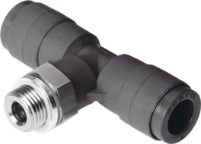
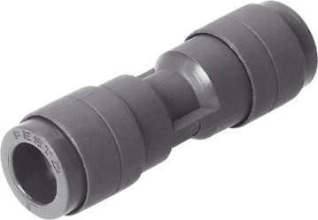
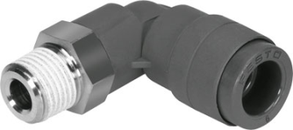
QS-V0 Fittings
Exit
Back
Range of applications
Resistant to welding spatter
Body in White
Features
Flame resistant material according to ULS4 - V5
Pressure- and temperature range
Temperature dependent operating pressure:
-0,95 … 10 bar
Ambient temperature:
0°C … +60°C

Slide 6











NPQP polypropylene fittings
Exit
Back
Range of applications
Food and beverage industry
Process industry
Cleanroom
Biotechnology/pharmaceuticals
Features
Polypropylene housing and thread
FDA listed material
Resistant to acids and cleaning agents
Corrosion resistance class CRC 4
Pressure- and temperature range
Temperature dependent operating pressure:
-0,95 … 10 bar
Ambient temperature:
-20°C … +60°C

Slide 7
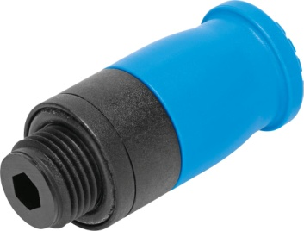
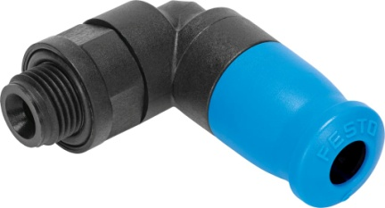
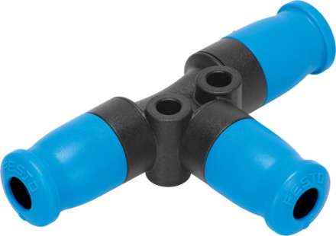
NPKA Polymer click fitting
Exit
Back
Range of applications
Food and beverage production
Electronics and semiconductor industries
Assembly of small workpieces and battery cells
Features
Lightweight, corrosion-free polymer
Free of non-ferrous metal, fluoride, silicon, grease
FDA listed material
Cleanroom compatible
Corrosion resistance class CRC 4
Pressure- and temperature range
Temperature dependent operating pressure:
-0,95 … 10 bar
Ambient temperature:
-10°C … +60°C

Slide 8
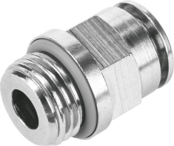
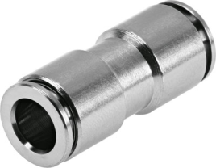
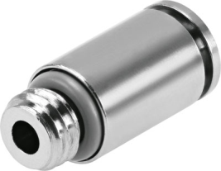
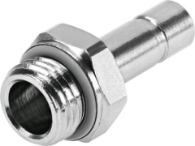
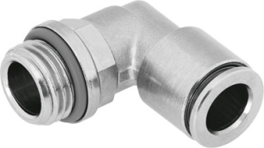
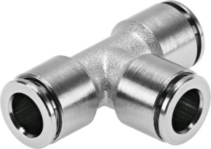
NPQH Metal fittings
Exit
Back
Range of applications
Food and beverage industry
Whenever a high level of chemical resistance and high temperatures are required
Features
Brass, chemically nickel-plated (15 µm)
Improved clamping technology
FDA listed material
Corrosion resistance class CRC 3
Pressure- and temperature range
Temperature dependent operating pressure:
-0,95 … 20 bar
Ambient temperature:
-20°C … +150°C

Slide 9



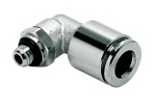












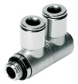
NPQM metal fitting
Exit
Back
Range of applications
Automotive
Wood machining
Electronics industries
ESD protected areas
Features
Housing and releasing ring made of nickel-plated brass
Anti-static
Pressure- and temperature range
Temperature dependent operating pressure:
-0,95 … 16 bar
Ambient temperature:
-20°C … +70°C

Slide 10
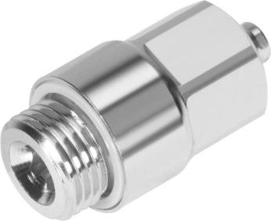
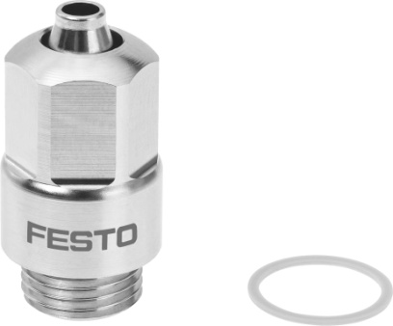
NPCK Clean Design stainless steel fittings
Exit
Back
Range of applications
Food and splash zone in the food industry
Process automation and the pharmaceutical industry
Features
Stainless steel housing: The design of the union nut avoids edges where dirt could accumulate
FDA listed material
Chemical and temperature resistant
Corrosion resistance class CRC 4
Pressure- and temperature range
Temperature dependent operating pressure:
-0,95 … 12 bar
Ambient temperature:
-20°C … +120°C

Slide 11
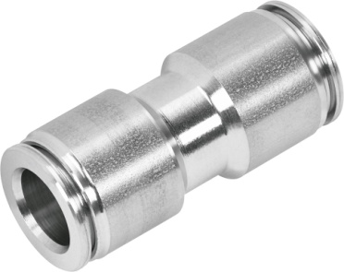
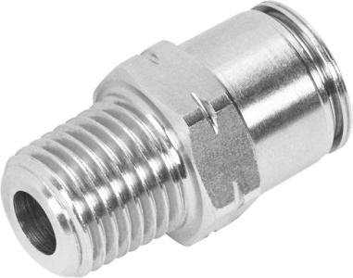
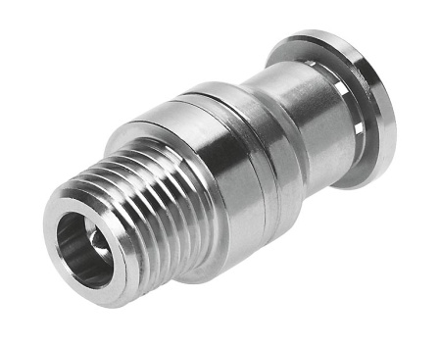
CRQS Stainless steel fittings
Exit
Back
Range of applications
Applications with extreme media influences
Food and splash zone in the food industry
In the outside, eg. process automation
Features
Stainless steel housing
EG10/2011 listed material
High chemical and temperature resistance
Corrosion resistance class CRC 4
Pressure- and temperature range
Temperature dependent operating pressure:
-0,95 … 10 bar
Ambient temperature:
-15°C … +120°C

Slide 12
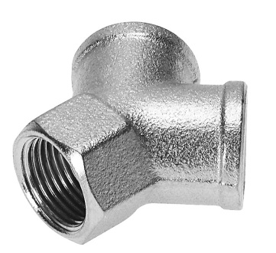
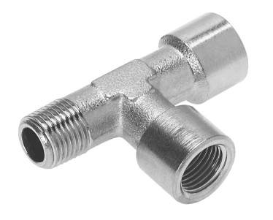
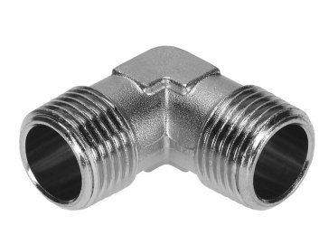
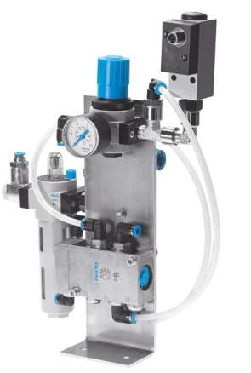
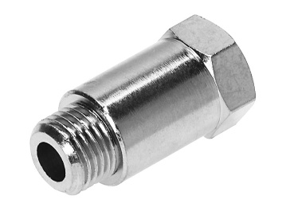
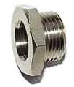
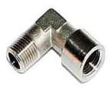
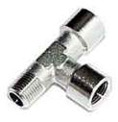
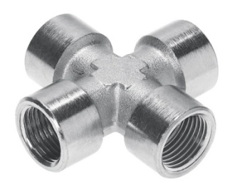
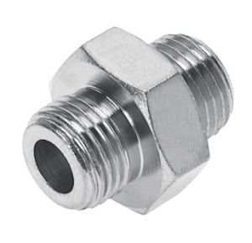
NPFC Threaded fittings
Exit
Back
Range of applications
Standard applications
Applications with high temperature and pressure ranges
Features
Nickel-plated brass
Pressure- and temperature range
Temperature dependent operating pressure:
-0,95 … 50 bar
Ambient temperature:
-20°C … +150°C

